Slide 1

Hospitality Analysis
Group-6

Slide 2
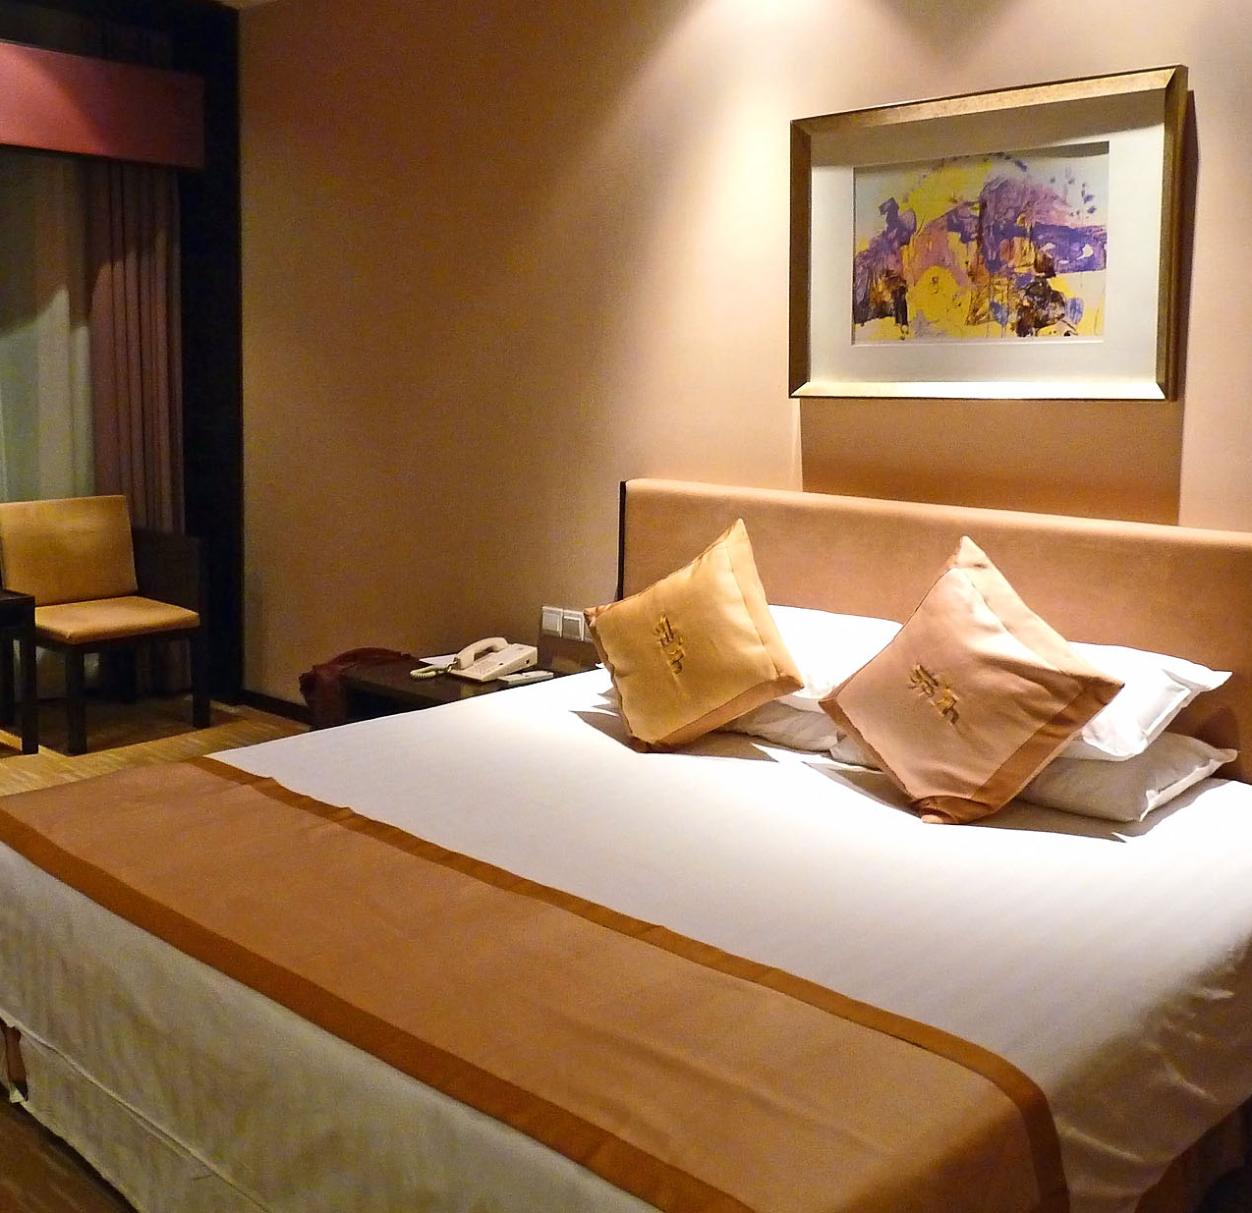
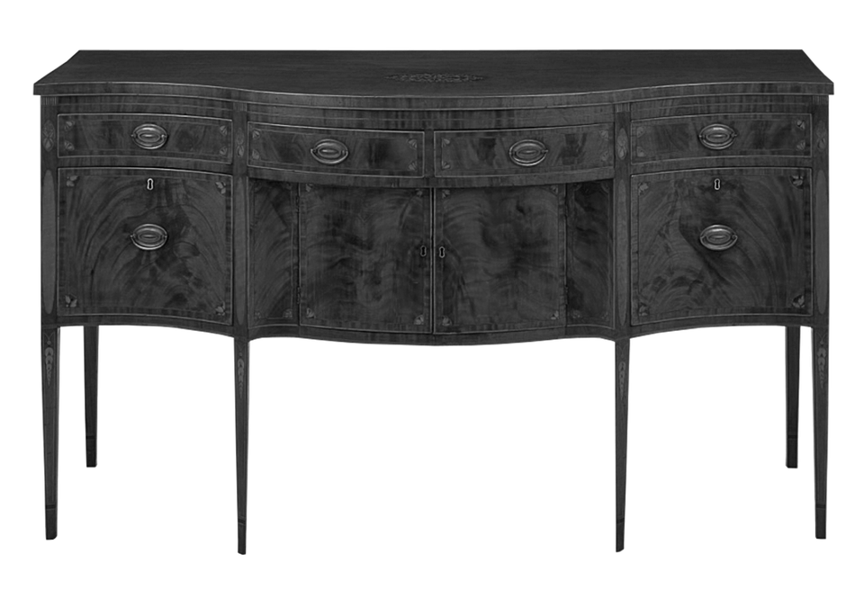
Introduction
Atliq owns several five-star hotels across India and has been in the hospitality business for 20 years. Recently, they have been losing market share and revenue in the luxury/business hotel category due to competition and poor management decisions. To address this, the managing director wants to use "Business and Data Intelligence" to help the company recover. Since they don’t have an in-house data analytics team, the revenue management team decided to hire a third-party service provider to analyze their historical data and provide insights.

Slide 3

Overview
The Atliq Grands Hospitality Analysis project looks at how well the company’s hotels are performing across India. By analyzing data and using visual tools, we discovered important trends, such as higher hotel bookings on weekends, more revenue from the Elite room class, and better results in Mumbai compared to other cities. We also found that Atliq Exotica is the top-performing property. Additionally, there are high rates of booking cancellations and no-shows. The goal of this project is to provide clear recommendations to help improve hotel operations, adjust pricing, and make better decisions to increase market share and revenue.

Slide 4
Objectives
Evaluate booking patterns across various locations and time periods to identify peak seasons and high-demand areas.
Examine customer reviews, ratings, and feedback to determine popular class type, and property
Pinpoint specific aspects of property operations, such as room cleanliness, service speed, staff responsiveness, and the quality of amenities, that require enhancement to boost customer satisfaction.
Analyze revenue data and occupancy trends to assess the financial performance of properties and optimize pricing strategies accordingly.

Slide 5
Methodology
The approach includes:
Extracting and cleaning data with Excel and SQL.
Analyzing data using advanced Excel functions and SQL queries.
Creating interactive dashboards and visualizations with Power BI and Tableau.

Slide 6

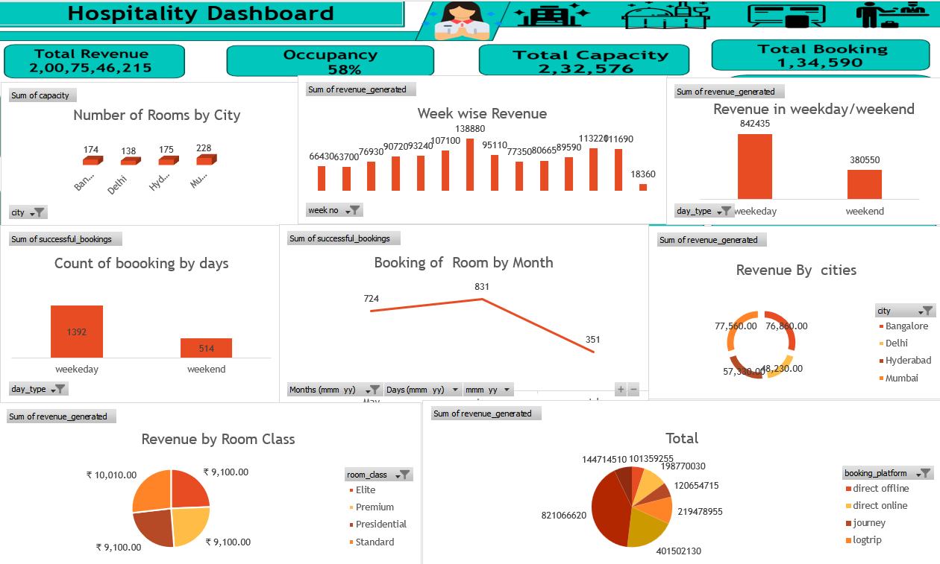
Excel Analysis
Used advanced Excel functions to clean, manage, and visualize data.
Created charts and graphs to show hotel data by class, ratings, revenue, and cities.
Analyzed data to find trends and patterns.

Slide 7

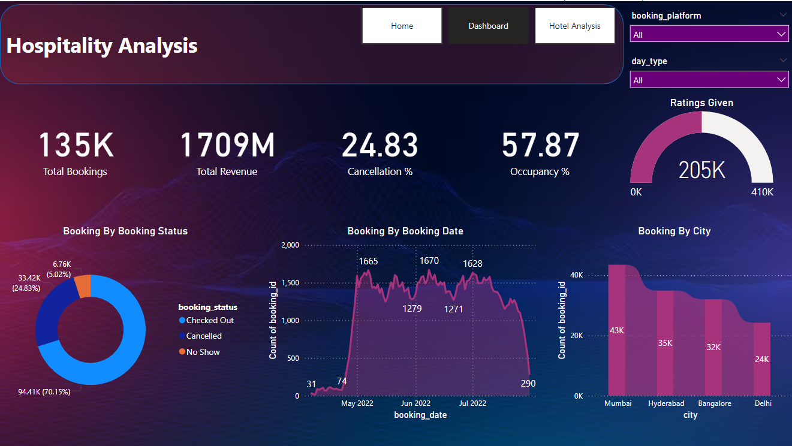
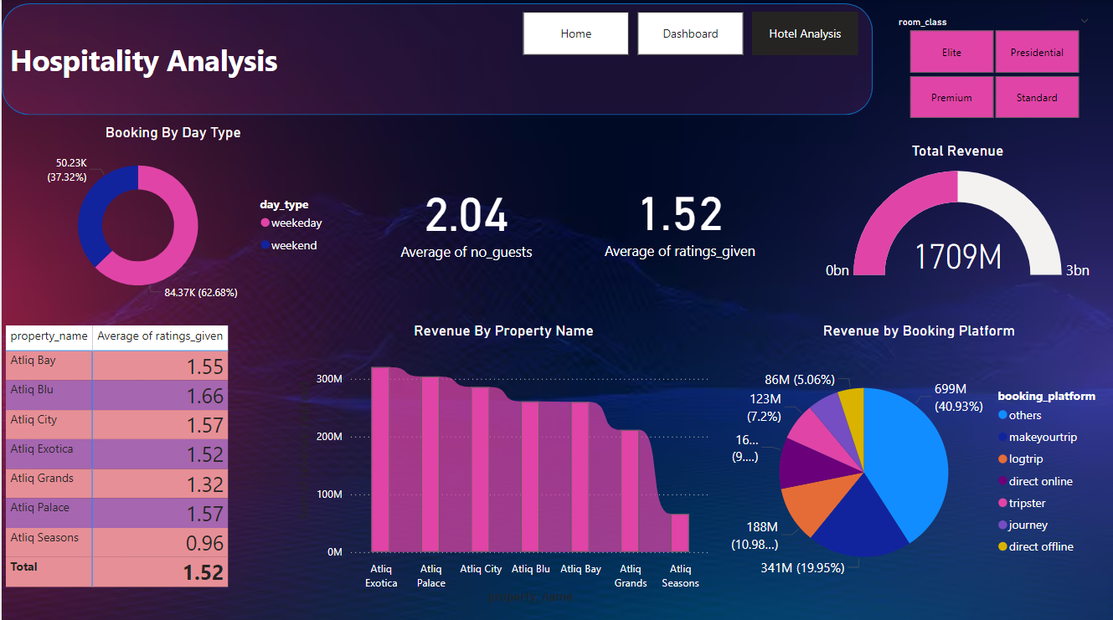
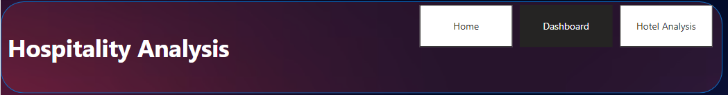
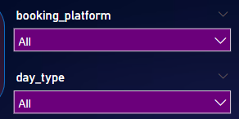
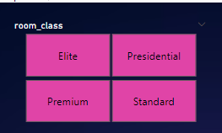
PowerBi Analysis
Made interactive dashboards in Power BI to show and analyze Hospitality data.
Created visuals to explore trends in location, ratings, revenue, and cuisine.
Added slicers, filters, and drill-down features for easy data exploration.

Slide 8

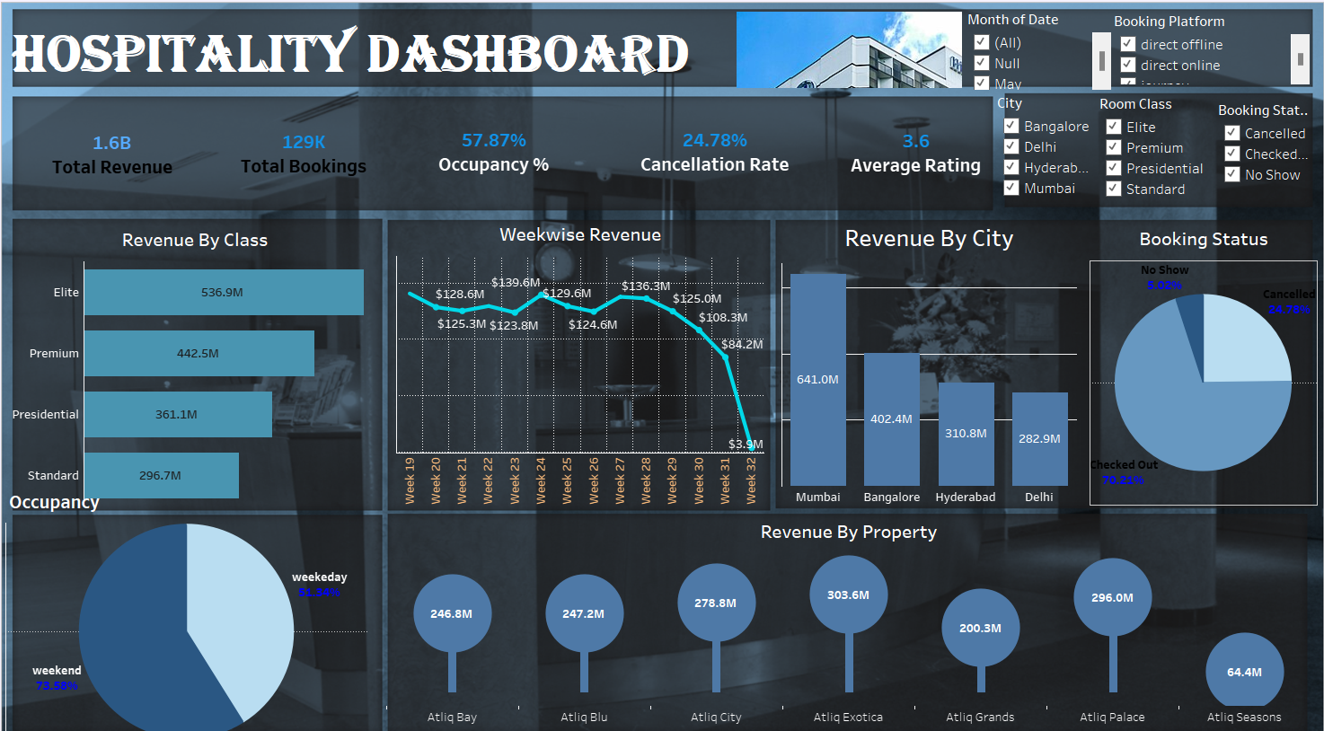
Tableau Analysis
Used Tableau to create visuals and analyze Hospitality data.
Made interactive dashboards to show trends in week, class and city wise revenue and other KPI’s.

Slide 9

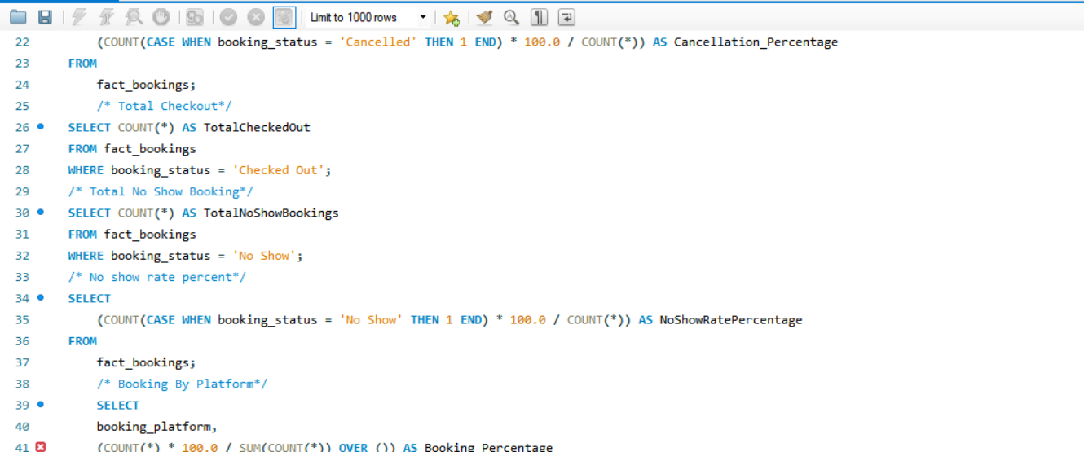
SQL Queries
Ran SQL queries to get and work with data from the database.
Measured things like the revenue generated by each property, trends in cities, average ratings, and class wise revenue.
Combined data from different tables using SQL joins and subqueries for better analysis.

Slide 10
Suggestions
Increase weekend promotions to attract more weekday bookings. Consider discounted rates, extended stay offers, or bundled services.
Focus on expanding or enhancing the Elite class offerings across more properties. This could include upgrading room amenities, exclusive services, and targeted marketing campaigns.
Capitalize on Mumbai’s market by strengthening the brand’s presence there. Invest in more advertising, partnership deals, and customer loyalty initiatives specific to the city.
Use Atliq Exotica’s success as a model for other properties. Identify the key drivers of its success (e.g., location, services, customer satisfaction) and apply those strategies to underperforming hotels.
Reduce cancellations and no-shows by implementing a more flexible cancellation policy, offering incentives for early check-ins or confirmations, and introducing a deposit system or overbooking strategies to offset lost revenue.
Enhance the offerings for Premium, Presidential, and Standard classes by adding more perks or value-added services to make these categories more attractive and competitive

